Slide 1

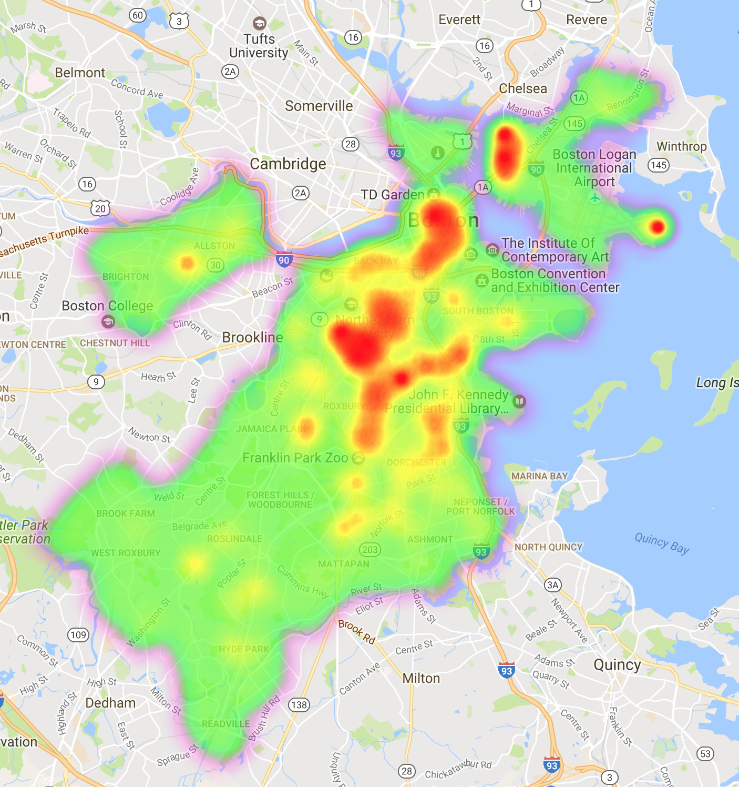
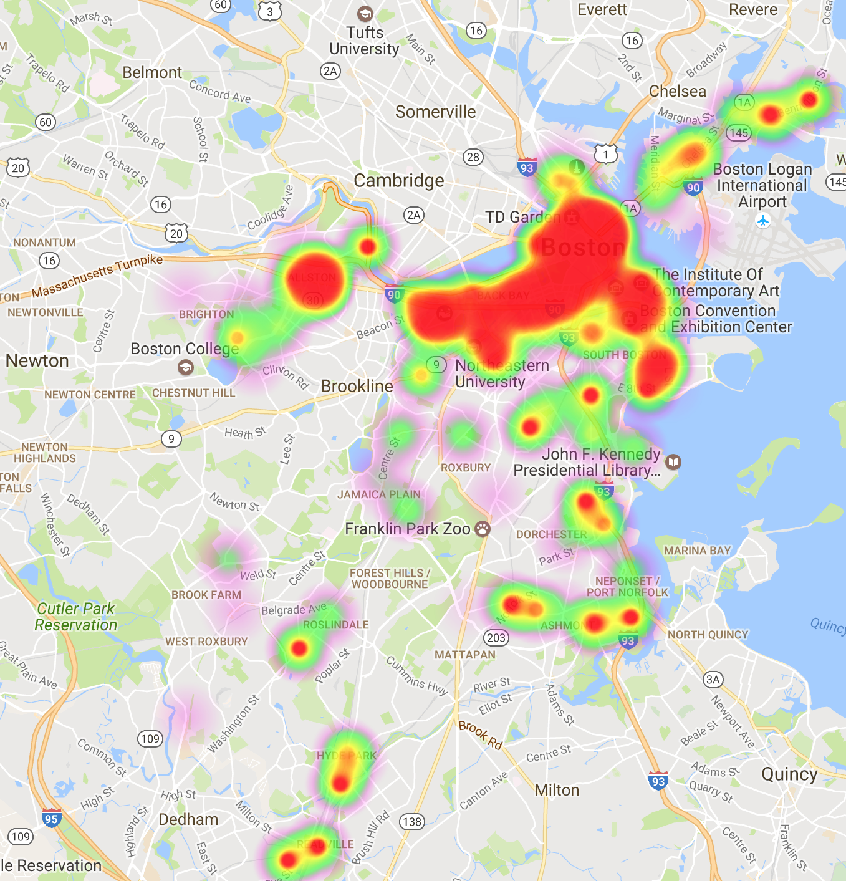
COMMUNITY SHIT
Project: Question: Given different types of city establishments that can either be categorized as indicators of "stronger” or "weaker community", can we find other correlations with other indicators of inequality or "instability" in Boston and address common problems in terms of this social aspect? Datasets: Crime Incident Reports (July 2012 - August 2015) Property Assessment Public Access Fishing Locations Active Food Establishment Licenses, Entertainment Licenses Community Supported Agriculture Pickups Year-Round Swimming Pools. Boston Parking Lots Boston Libraries Methodology: These data sets were combined as a preliminary test to this question, using crime statistics, and seeing if there was a correlation in the 1000x1000-foot cells with crime incidence and what we scored as a "community value". The public fishing locations, community supported agriculture pickups, and library locations were grouped and taken to be "community indicators”. The entertainment, active food establishment license, and parking lot locations were taken to be "anti-community indicators" -- with the rationale that entertainment is a form of escapism from where one currently is (with large parking lots/garages designated as private, doing no public good), and that food establishments similarly exist to give people a break from eating around their community (and often being tourist spots as well). |  | STUFF 3

